Slide 1
Waxmanlab Computational Session
Session I
8/13/2018
Instructor: Kritika Karri
kkarri@bu.edu

Slide 2
Your Background
Who has used SCC before ?
How long have you worked on SCC ?
Who has worked on any other cluster ?
Do you have previous experience working with basic linux and command line usage (CLI)?

Slide 3

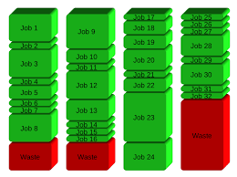

What is SCC ?
Shared Computing Cluster (SCC)
  Shared: Multi-user, Multi-tasking environment.
  Computing: Interactive jobs, Single processor and parallel jobs,Graphics job etc.
  Cluster: Nexus of computers connected by a fast local area network which coordinated the computational workload via job scheduler

Slide 4







Massachusetts Green High Performance Computing Center
Notes:
State-of-the-art data center in Holyoke, MA.
MGHPCC provides physical infrastructure (i.e. space, power, cooling), not computing systems.
Individual universities or consortiums provide their own computing and support

Slide 5
A computer cluster and node
A computer cluster is a set of loosely or tightly connected computers that work together so that, in many respects, they can be viewed as a single system.
Computer clusters have each node set to perform the same task, controlled and scheduled by software.
The components of a cluster are usually connected to each other through fast local area networks, with each node (computer used as a server) running its own instance of an operating system.

Slide 6
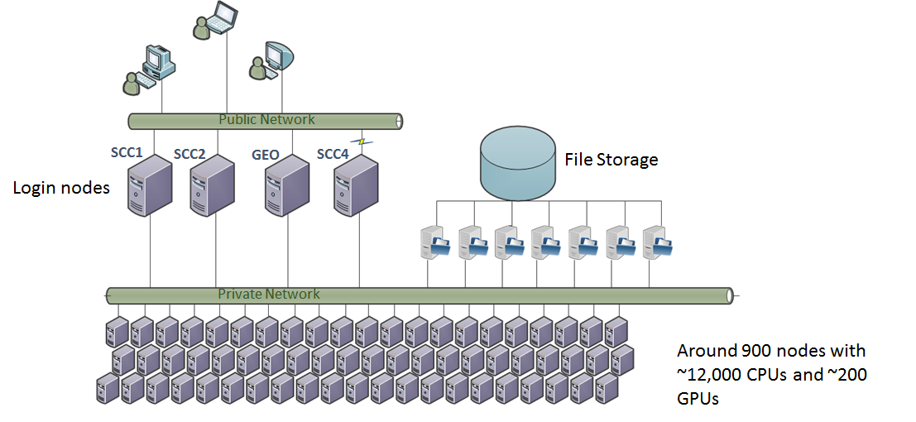
SCC Architecture

Slide 7
SCC General Limits
•All login nodes are limited to 15min. of CPU time
•Default wall clock time limit for all jobs – 12 hours
•Maximum number of processors – 1000
•1 processor job (batch or interactive) – 720 hours
•omp job (16 processors or less) – 720 hours
•mpi job (multi-node job) – 120 hours
•gpu job – 48 hours
•Interactive Graphics job (virtual GL) – 48 hours

Slide 8
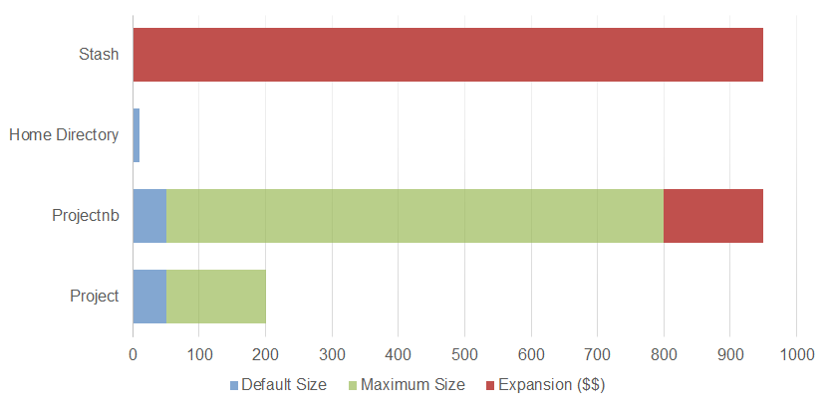
Storage (GB)
In general
Home Directory – Personal files, custom scripts.
/project – Source code, files you can’t replace.
/projectnb – Output files, downloaded data sets. Large quantities of data that you could recreate in the incredibly unlikely event of a disastrous data loss.
Restricted data (dbGAP)
/restricted/project/PROJNAME backed up space for dbGaP data
/restricted/projectnb/PROJNAME – not backed up space for dbGaP data
Only accessible through scc4.bu.edu and compute nodes.
Notes:
§Research projects are by default granted 50GB of backed-up spaced (/project/PROJNAME) and 50GB of not-backed-up space (/projectnb/PROJNAME). These numbers can be increased for free to 200GB/800GB.
§Project groups can either purchase or “rent” additional storage.
§All users have a Home Directory with a 10GB quota.

Slide 9
Waxman lab project structure on scc
root(/)
restricted
projectnb
project
protected
wax-dk
wax-es
projectnb
waxmanlab
wax-dk
projects
waxmanlab
wax-es
net
waxman-server
mnt
data

Slide 10
Scratch Space
Each node (login or compute) has a directory called /scratch stored on a local hard drive.
  This can be used by batch jobs to quickly write temporary files.
If you wish to keep these files, you should copy them to your own space when the job completes.
Scratch files are kept for 30 days, with no guarantees.

Slide 11
Types of Jobs
Interactive job – running interactive shell: run GUI applications, code debugging, benchmarking of serial and parallel code performance;
Interactive Graphics job ( for running interactive software with advanced graphics )
Batch job – Execution of the program without manual intervention;

Slide 12

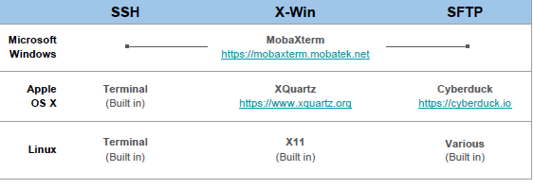
Software to Access SCC

Slide 13
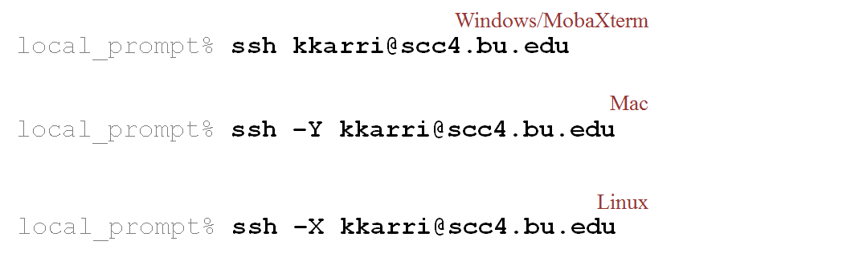
How to connect with SCC

Slide 14
Working with SCC Part I: Navigating through files
Essential navigation commands:
pwd print current directory
ls list files
cd change directory
We use “pathnames” to refer to files and directories in the Linux file system. There are two types of pathnames:
Absolute – the full path to a directory or file; begins with /
Relative – a partial path that is relative to the current working directory; does not begin with /
Special characters interpreted by the shell for filename expansion:
~ your home directory
. current directory
.. parent directory
* wildcard matching any filename
? wildcard matching any character
TAB try to complete (partially typed) fi (very useful !!!)

Slide 15
List of useful commands
Useful options for the “ls” command:
◦ls -a List all files, including hidden files beginning with a period “.”
◦ls -ld * List details about a directory and not its contents
◦ls –l Simple long listing
◦ls –lR Recursive long listing
◦ls –lh Give human readable file sizes
◦ls –lS Sort files by file size
◦ls –lt Sort files by modification time (very useful!)
cp [file1] [file2] copy file
mkdir [name] make directory
rmdir [name] remove (empty) directory
mv [file] [destination] move/rename file
rm [file] remove (-r for recursive)
file [file] identify file type
less [file] page through file
head -n [file] display first n lines
tail -n [file] display last n lines
cat [file] [file2…] display file(s)
tac [file] [file2…] display file in reverse order

Slide 16
Word Count
Count everything
  [kkarri@scc4 ~]$ wc ncRNA_pfam.output
  1158238 6690230 57727093 ncRNA_pfam.output
Count lines
  [kkarri@scc4 ~]$ wc -l ncRNA_pfam.output
  1158238 ncRNA_pfam.output
Count words
  [kkarri@scc4 ~]$ wc -w ncRNA_pfam.output
  6690230 ncRNA_pfam.output

Slide 17

Hands on practice I
In this session we will practice the basic commands to create folders in a specific directory and copy files.
Connect to scc4@bu.edu with your kerberos username and password
Access the waxmanlab project folder ~/restricted/projectnb/waxmanlab
Create a folder under your name
Copy the sample folders assigned to your from the G166 series.
Copy Sample_Labels.txt file to your folder from the following folder
/restricted/projectnb/waxmanlab/routines/RNASeq_Paired_End_v2.3.0/Scripts/00_Setup_Pipeline

Slide 18
Working with SCC Part II: Working and Managing Files and Directories
File Editors
Vim : A better version of ‘vi’ (an early full-screen editor).
Gedit: Notepad-like editor with some programming features . Requires Xwindows.
Others : nano, emacs
Notes:
In the right hands, is efficient, fast. Still popular among systems programmers. Non-Xwindows.

Slide 19
Vim Mode
Normal – navigation, text manipulation
Arrow keys
p to put yanked text
x to delete character under cursor
dd to delete current line
: to enter command mode
Insert – for adding new text
Enter by typing i when in normal mode
Exit by hitting ESC
Visual – for selecting text
Enter by typing v when in normal mode
Copy (yank) text by typing y
Command (entered via “:” from normal mode)
q Quit
q! Quit without saving
w filename Write filename
help Get help (extensive)

Slide 20
gedit GUI Editor
Try launching a graphical application, such as gedit:
Command : gedit test
Assuming you have X Forwarding set up, this should bring up in a separate window the simple editor gedit to enable you to edit your source code file. Other editors such as emacs and vi are also available.

Slide 21
Permissions
Files Access Control:
Every file has an owner.
Every file belongs to a group.
Every file has “permissions” controlling access to it.
[kkarri@scc4 ~]$ drwxr-xr-x 3 kkarri waxmanlab 512 Jan 21 16:03 newdir
“drwxr-xr-x” gives the “permissions” for this directory (or file). The “d” indicates this is a directory. There are then three sets of three characters for “user” (u), “group” (g), and “other” (o) access levels. “r” indicates a file/directory is readable, “w” writable, and “x” executable. A “-” indicates no such permission exists.

Slide 22

chmod
Change the permissions on the directory “newdir” so that members of your group can write to it:
[kkarri@scc4 ~]$ chmod g+w newdir
[kkarri@scc4 ~]$ ls -l
total 0
drwxrwxr-- 3 kkarri waxmanlab 512 Jan 21 16:03 newdir

Slide 23

Decoding chmod
The chmod command also works with the following mappings, readable=4, writable=2, executable=1, which are combined like so:
[kkarri@scc4 ~]$ ls –l newdir
drwxrwxr-x 3 kkarri waxmanlab 512 Jan 21 16:03 newdir
[kkarri@scc4 ~]$ chmod 750 newdir
[kkarri@scc4 ~]$ ls -l newdir
drwxr-x--- 3 kkarri waxmanlab 512 …

Slide 24
Compressing and decompressing files
tar (Tape ARchiver) : To create a disk file tar archive. Here are the options we are using:
  -z: Write the archive through gzip
  -c: Create a new tar archive
  -v: Verbose, show the files being worked on as tar is running
  -f: Specify the name of an archive file
    Example: $tar -zcvf moe.tar.gz /home/moe
To restore files from a tar archive, use
$ tar -zxvf archivename
gzip is a utility for compressing and decompressing individual files. To compress files, use:
  $ gzip filename
  The filename will be deleted and replaced by a compressed file called filename.Z or filename.gz. To reverse the compression process, use:
  $ gzip -d filename
viewing compressed text files with zcat
  $ zcat geneList.gz , $ zcat geneList.gz | head

Slide 25
Executing a script
Shell Script : sh script_name.sh
Rscript : Rscript script_name.R
C/C++ program : Compile : gcc hello.c -o hello1 Execute: ./hello1
Python : python script_name.py

Slide 26
Working with SCC Part III: Working with Environment and batch jobs
Modules – Used to load applications not automatically loaded by the system, including alternative versions of applications.
Check the available modules
[kkarri@scc4 new_cuffmerge]$ module avail R
Load a module in current environment
[kkarri@scc4 new_cuffmerge]$ module load R/3.4.0
Unload a module
[kkarri@scc4 new_cuffmerge]$ module unload R/3.4.0
To check the version of a tool or software
[kkarri@scc4 new_cuffmerge]$ which R

Slide 27
Batch Jobs – qsub and qstat
Use the Open Grid Scheduler (OGS) command qsub to submit the compiled program to the batch system:
[kkarri@scc4 stranded]$ qsub stranded_transcriptome.qsub
[kkarri@scc4 stranded]$ qsub -P waxmanlab stranded_transcriptome.qsub
Check the status of your job qstat
[kkarri@scc4 stranded]$ qstat -u kkarri
job-ID prior name user state submit/start at queue slots ja-task-ID
---------------------------------------------------------------------------------------------------------------
3987947 0.11135 QLOGIN kkarri r 01/20/2018 11:23:05 linga@scc-ka8.scc.bu.edu 32
3990472 0.11118 new_cuffme kkarri r 01/21/2018 13:09:13 mem512@scc-wj3.scc.bu.edu 28

Slide 28
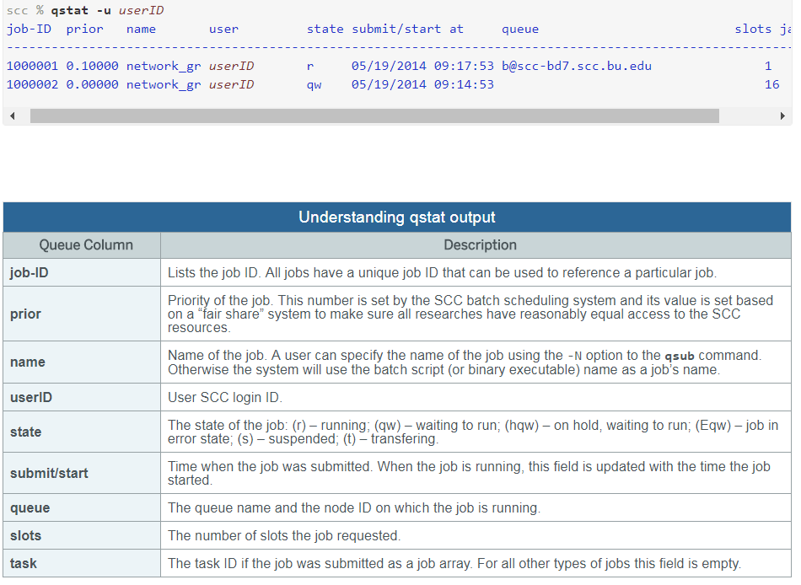
Understanding qstat output

Slide 29
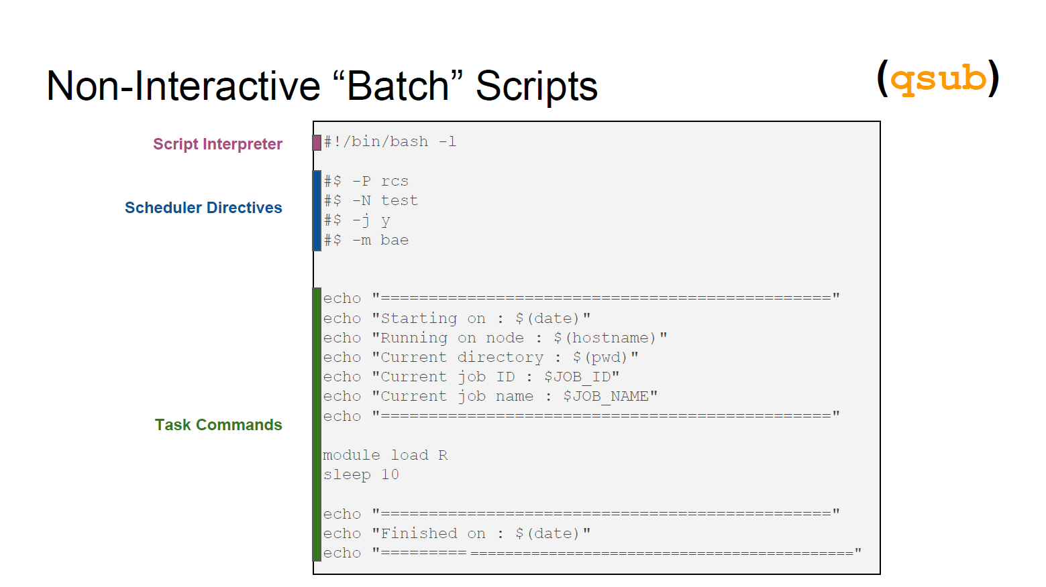

Slide 30
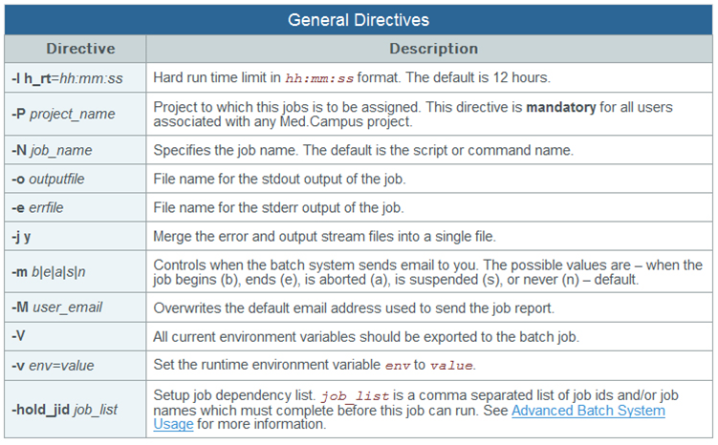

Slide 31
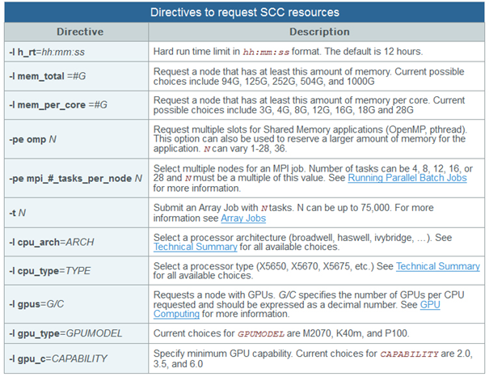

Slide 32
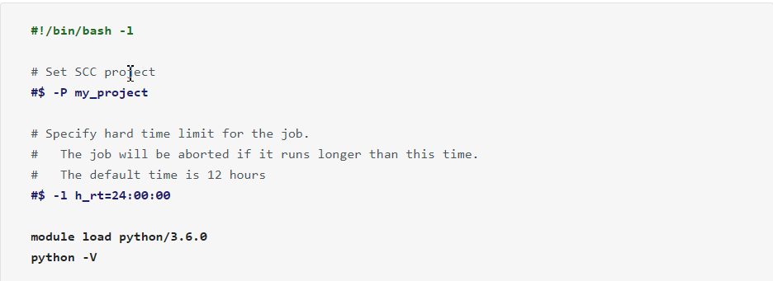
Customizing parameters based on your job requirement

Slide 33
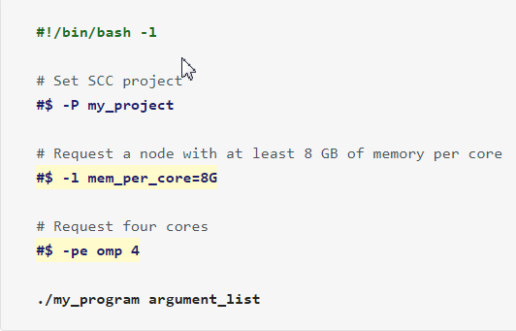
Large Memory Jobs (Upto 64GB)

Slide 34
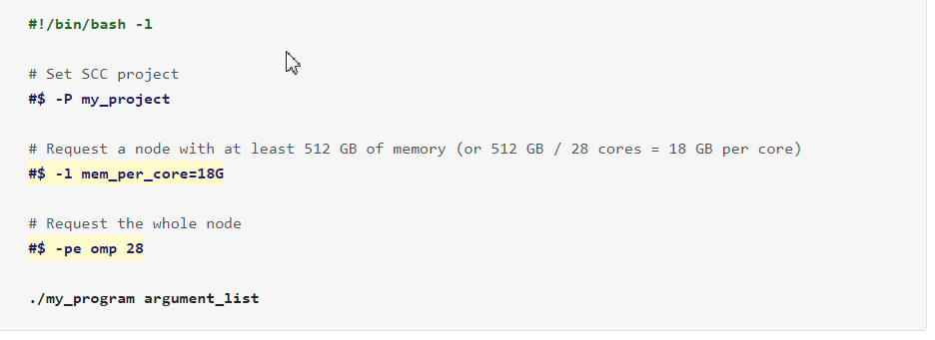
Very large Memory Jobs (more than 64GB)

Slide 35
Delete single or multiple jobs
Usingqdel command and Job id you can request to delete a job
  [kkarri@scc4 stranded]$ qdel 3992851
  kkarri has deleted job 3992851
Delete Multiple jobs using a pattern or keyword:
  killing all jobs that started with cuff
    qstat -u kkarri | awk '$3 ~ "cuff" {cmd="qdel " $1; system(cmd); close(cmd)}'
  ends with certain string (i already have an alias called job that will give me the full name of job)
    qstat -u kkarri | awk '$3 ~ "featureCount$" {cmd="qdel " $1; system(cmd); close(cmd)}'

Slide 36
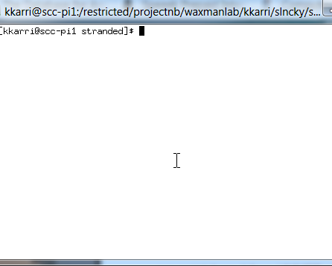
qsh interactive session
Request an interactive session using qsh
  [kkarri@scc4 stranded]$ qsh -P waxmanlab
Your job 3992885 ("INTERACTIVE") has been submitted
waiting for interactive job to be scheduled …
Request an interactive session using qlogin
  [kkarri@scc4 stranded]$ qlogin -P waxmanlab -pe omp 16 -l h_rt=12:00:00 #asking for 16 cores
More number of core requested , more time to get access to the session !!!!

Slide 37
Screen Command
The screen application is very useful, if you are dealing with multiple programs from a command line interface and for separating programs from the terminal shell. It also allows you to share your sessions with others users and detach/attach terminal sessions.
Open a new screen
  [kkarri@scc4 stranded]$ screen -S test
  [kkarri@scc4 stranded]$ screen -ls
Detach a screen : One of the advantages of screen that is you can detach it. Then, you can restore it without losing anything you have done on the screen. you can press “Ctrl-A” and “d”
Restore a screen
  [kkarri@scc4 stranded]$ screen -r 168402
Screen also have shortcut to lock the screen. You can press “Ctrl-A” and “x” shortcut to lock the screen.

Slide 38
Hands-on Terminal Session II
fastqc A quality control tool for high throughput sequence data(will discuss in detail in coming lectures)
The input for this tool is a .fastq.gz file and the command to run is “fastqc name.fastq.gz”
Copy the test.qsub script from /restricted/projectnb/waxmanlab/kkarri/Session1
Open the script in vim or gedit and edit the script by specifying incomplete parameters ( In CAPITALS)
Add the fastqc command using the SRR1177960_R1.fastq.gz file located in /restricted/projectnb/waxmanlab/kkarri/Session1 folder (hint: use pwd to get the file path)
Submit test.qsub as batch job and check the status of your job.

Slide 39
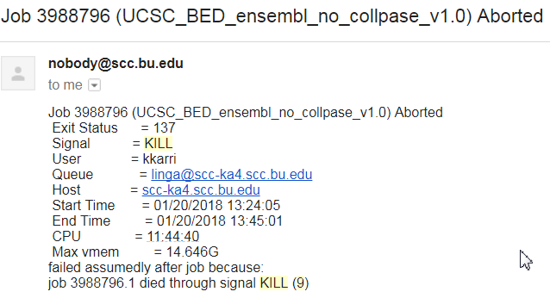

Signal Kill (9) error
What happens if you use more slots than
requested?
● We kill it to preserve other jobs running on
that node.
If you have email notifications enabled, you will
receive a notice that the job was aborted.
● Note that it ran for 9 minutes and the CPU
ran for 22.
You will also receive an explanation email.
Notes:
9 Means KILL signal that is not catchable or ignorable. In other words it would signal process (some running application) to quit immediately"

Slide 40

Discussion Questions
For the following jobs, what according to you would be a suitable mode of job run on scc- an interactive session (qsh,qlogin) or batch job (qsub)
  Alignment of ~50 millions raw sequencing reads to a large reference genome.
  Run a compute process > 15 min
  Run a job > 12hrs

